Slide 1

Time series data analysis and forecast methods
Lecture 1
Time series definition and typical models

Slide 2

Lecture map
Time series definition
Time series analysis problems
Time series classification
Stationary and non-stationary data, ergodicity definition
Typical time series models
Typical components of those models

Slide 3
PART 1. TIME SERIES DEFINITION

Slide 4
Time Series
= One partial sample data from the entire assembly of stochastic variable, which is characterized by some distribution function
= Time sample of this data

Slide 5
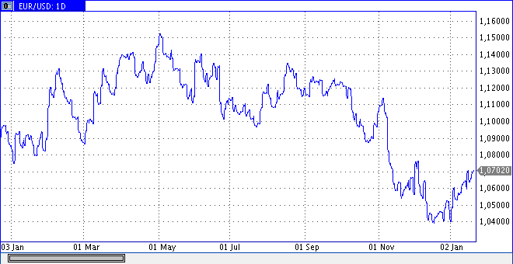

Slide 6
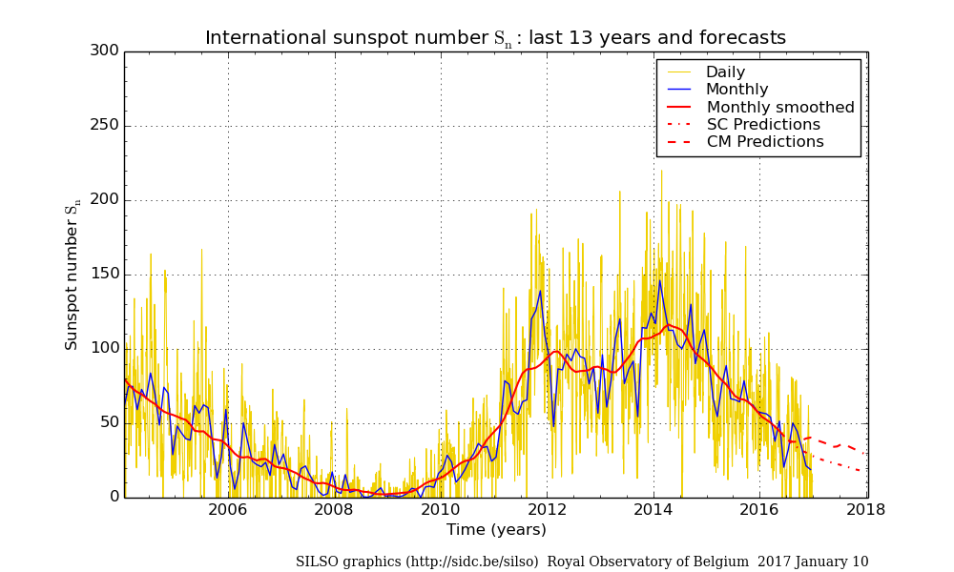

Slide 7
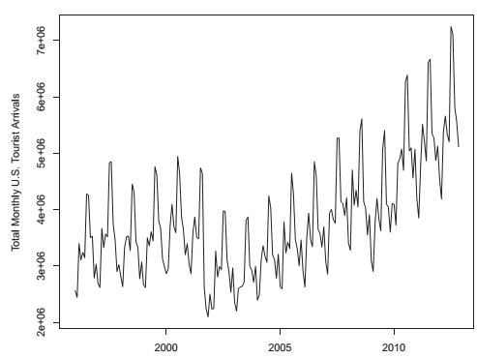

Slide 8
Time series analysis
Estimation of quantitative characteristics for initial process, that generated the time series data, making it possible to study and understand the concealed stochastic variable;
Quantitative and qualitative comparison between time series arrays in order to find similarities and distinctions of their initial generating process;

Slide 9
Time series analysis
Description and estimation of formal models, that we can use to define, evaluate and forecast the initial generating process data
Time series decomposition in order to find elementary components/modes with needed stochastic, statistical and periodic qualities

Slide 10
PART 2. TIME SERIES CLASSIFICATION

Slide 11
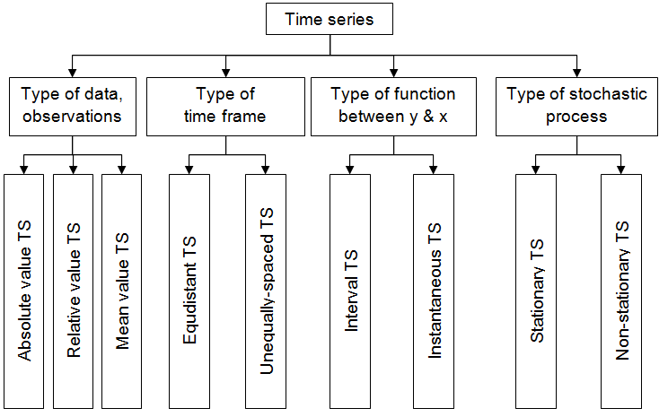

Slide 12
Time series (TS) classification
Type of classification | Type of time series classes
Type of data, levels, observations | Absolute value TS Relative value TS Mean value TS
Type of time frame | Equidistant TS Unequally-spaced TS
Type of function between observations and time frames | Interval TS Instantaneous TS
Type of generating stochastic process | Stationary TS Non-Stationary TS = NS time series

Slide 13
Type of observations
Absolute values (pt., kg, m, pieces …)
Relative values (USD/EUR)
Mean values
(monthly mean values, yearly mean values)

Slide 14
Type of time frame
Equidistant time series
Time frame is constant
Unequally-spaced time series
Time frame is variable

Slide 15
Interval or instantaneous data
Interval time series
- times series have absolute level/observation values divided by result from concrete stipulated time interval (numbers in a week, in an hour, in a day, etc.);
Instantaneous time series
- time series have instantaneous data point in any given time point;

Slide 16
Type of stochastic process
Stationary Time Series
Non-Stationary Time Series

Slide 17
Narrow sense Stationary process
Wide sense Stationary process
First and second dimensions of probability density are time-independent
Expectation (average of distribution) value and variance (dispersion) are time-independent

Slide 18
Ergodic process
Stationary stochastic process is the ergodic process, when the estimation process of its statistical characteristics by ensemble averaging is equal to the estimation process of its statistical characteristics by time averaging, where time span is theoretically infinitely long.

Slide 19
Real Time Series Data
Almost always non-stationary;
Sometimes can be estimated as semi-stationary;
Small number of stationary data.

Slide 20
PART 3. TYPICAL TIME SERIES MODELS

Slide 21
Base time series model
Time Series Data/observations/levels,
deterministic (non-stochastic) part of model, often represented as some combination of simple modes or time-dependent components,
stochastic part of model.

Slide 22
Additive time series model
trend (or tendency);
j seasonal component (season);
k periodic component (cycle),
coefficients of presence or lack of components

Slide 23
Trend
Stable regularity observed on the whole available time span:
Monotonic function;
Very Low-frequency component;

Slide 24
Trend

Slide 25
Seasonal components
Semi-periodic regular oscillations, often multiple of sampling time
Multiple of hours, days, weeks, months, years, etc.

Slide 26
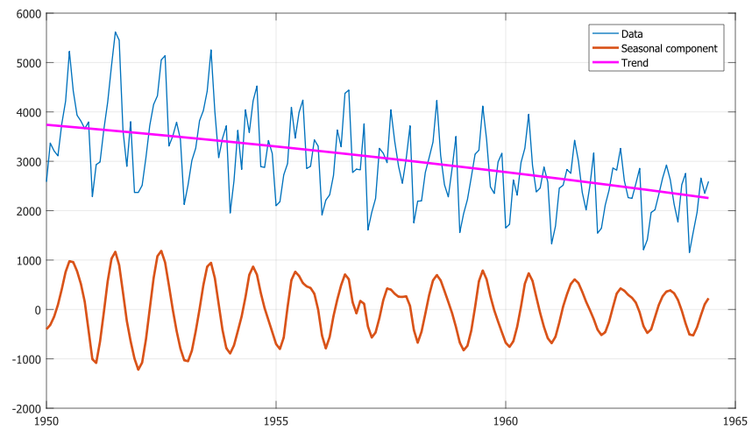
Seasonal components

Slide 27
Cycles
Long periods of time with variable amplitudes and length of time
Cycles represent in time series some settled components, which repeat itself in process with some minor variations in its characteristics (amplitude modulation, frequency modulation, phase modulation, etc.)

Slide 28
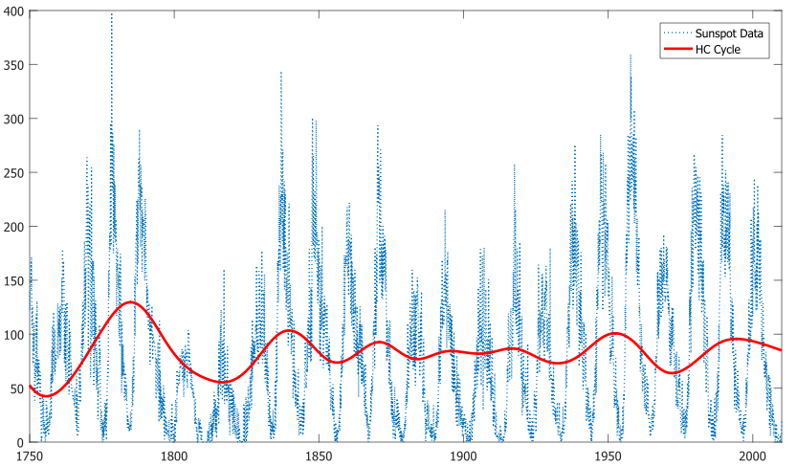
Cycle

Slide 29
Multiplicative model of time series
Composite or hybrid model

Slide 30
Autoregressive model
Function f shows connection between current and previous values of data;
Function g shows connection between current values of data and previous values of some random impulses

Slide 31
References
Box G., Jenkins G. Time Series Analysis: Forecasting and Control. — 4th ed. Wiley. — 2008. — 784 p.
Robert H. Shumway, David Stoffer. Time Series Analysis and Its Applications. — Springer Texts in Statistics, 4th ed. — 2016. — 550 p. ISBN 978-3-319-52451-1
David R. Brillinger. Time Series: Data Analysis and Theory. — SIAM. — 2001. — 540 p.
Karter J. Time series analysis with MATLAB. ARIMA/VARMAX/GARCH/GJR Models. Functions and Examples. — 2016. — 422 p. ISBN 978-1-539-54638-2.

